Slide 1
Muslim veneration of biblical prophets

Slide 2
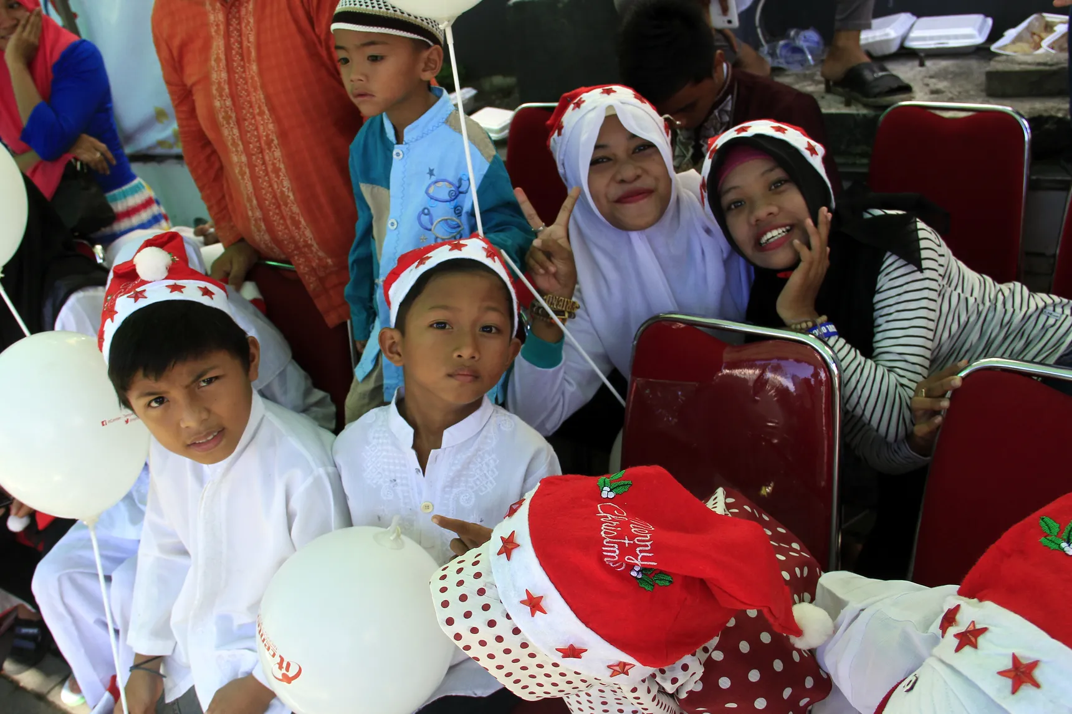
Jesus (Isa)
This photo shows Muslims in Indonesia taking part of a Christmas parade. Muslims believe in Jesus and his miracles. He was bestowed the Gospels (Injī). Rumi, a famous Muslim poet once said, “The hermitage of Jesus Is the Sufi’s table spread; Take heed, O sick one, Never forsake this doorway”. To Sufi’s Jesus is considered the perfect Sufi master. He is highly respected in the Quran and retains the title of Messiah within the Quran. The Prophet also referred to him as a brother.

Slide 3
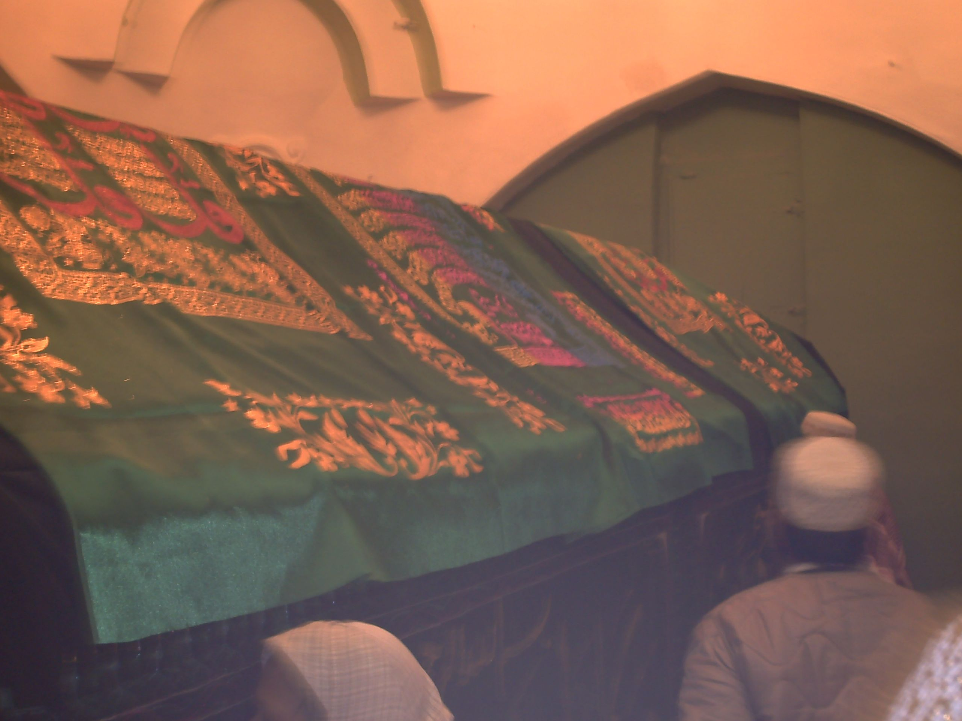
Moses (Musa)
In this photo Muslims gather at what they consider to be the tomb of Moses located in a Mosque. Moses is venerated an important prophet and figure in Islam. He is the most frequently mentioned individual in the Quran. Moses was given the Torah (Tawrat).

Slide 4
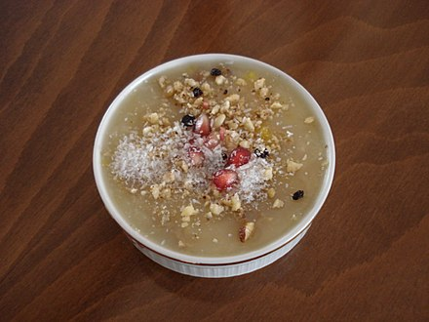
Noah (nuh)
This pictures shows a Turkish dish called Ashure or “Noah’s pudding”. Which is said to be eaten by Noah and his family to celebrate the end of the flood. Noah and the story of the Ark are known in Islam. An entire chapter (surah) is named after Noah.

Slide 5
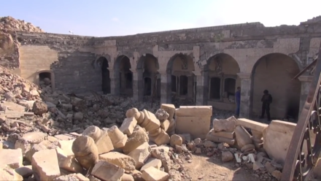
Jonah (Yunus)
This picture is the mosque of Jonah which was destroyed by ISIL. In the Quran Jonah is also swallowed by the whale. He is also the only prophet out of the twelve minor prophets mentioned in the Quran.

Slide 6
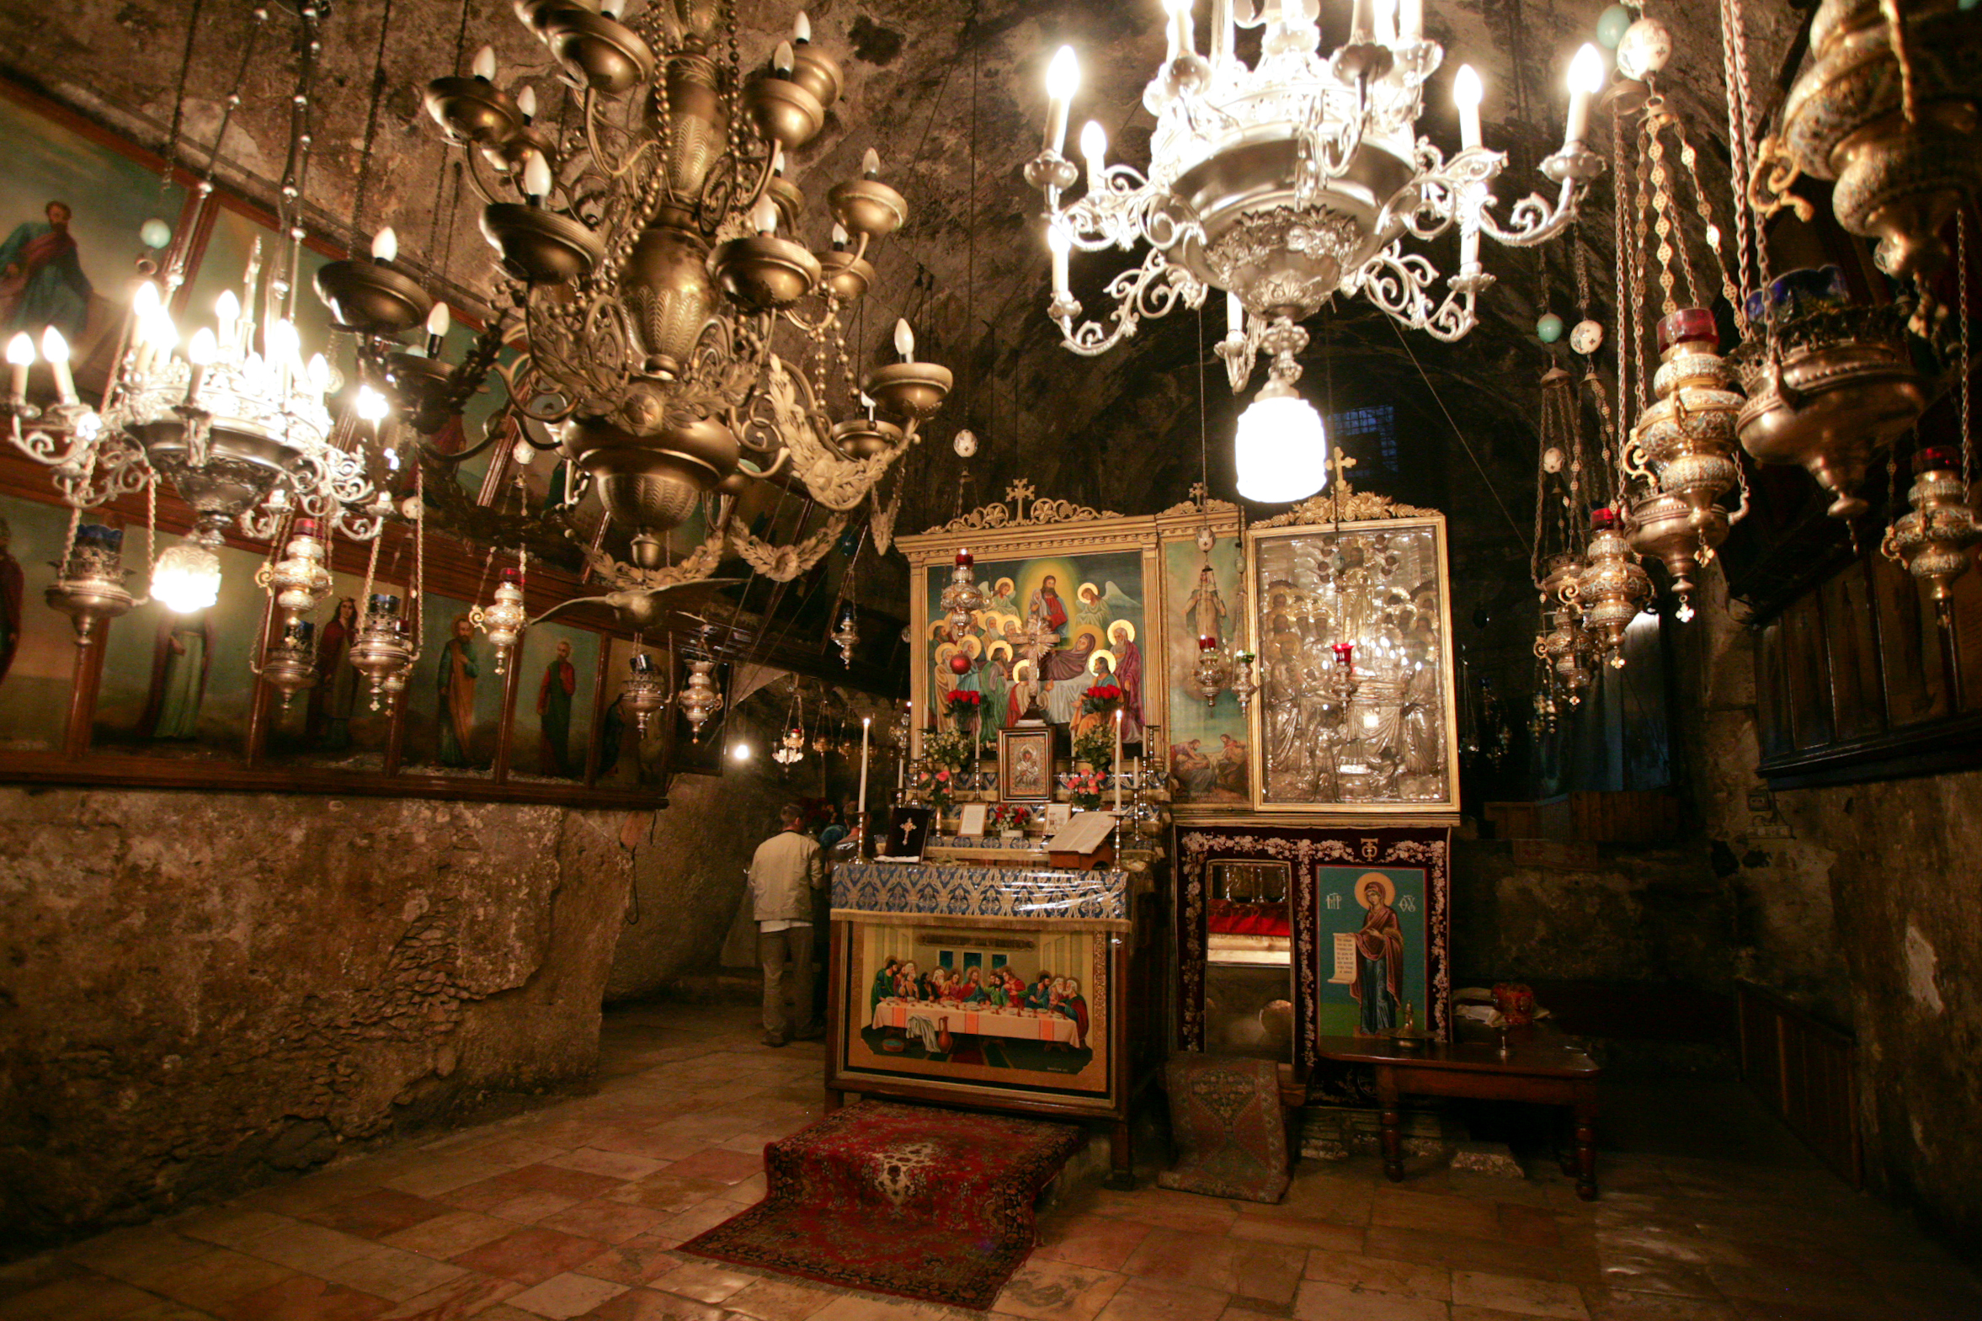
Mary (Maryam)
This picture shows the tomb of Mary. She is revered in the Quran as one of the most righteous women to ever have lived and some view her as a prophet. She is the only women to be referred to by name in the Quran. She has a chapter (surah) in the Quran named after her. In Islam she is known as the mother of Jesus. She also gave birth as a virgin within the Quran.

